Slide 1
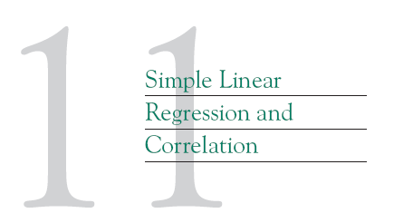

Slide 2
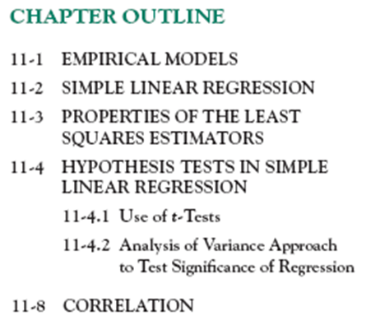
Notes:
1, 2, 4, 24a, 24d; 64

Slide 3
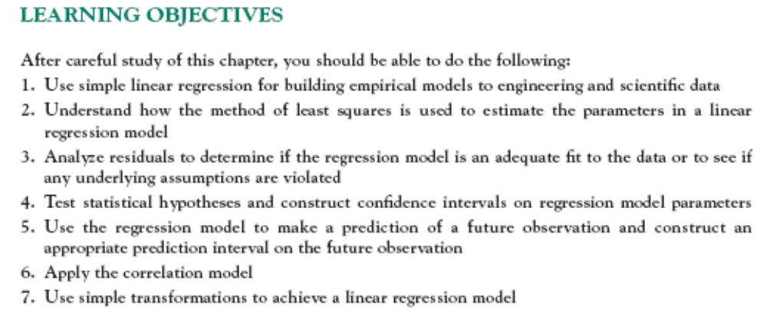

Slide 4
11-1 Empirical Models
Regression analysis is the process of building mathematical models or mathematical functions that can describe, predict or control of a variable from one or more other variables.
Many problems in engineering and science involve exploring the relationships between two or more variables.
Regression analysis is a statistical technique that is very useful for these types of problems.
Notes:
Predict: du doan
Yield: san luong

Slide 5
11-1 Empirical Models
For example , suppose that a car rental company that offers hybrid vehicles charts its revenue as shown below. How best could we predict the company’s revenue for the year 2016?
Year, x | 1996 | 2001 | 2006 | 2011 | 2016
Yearly Revenue, y (in millions of dollars) | 5.2 | 8.9 | 11.7 | 16.8 | ?

Slide 6
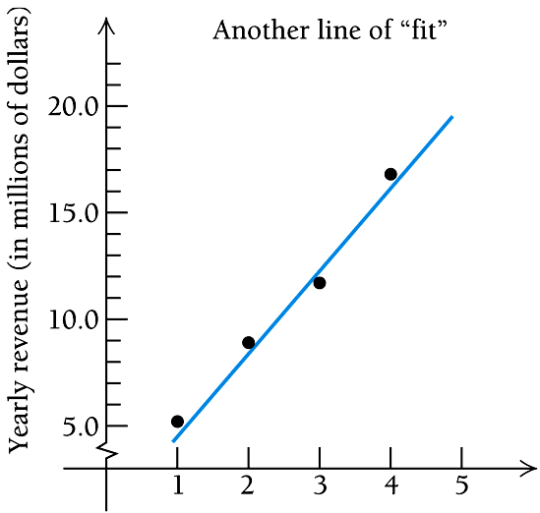
11-1 Empirical Models
Suppose that we plot these points and try to draw a line through them that fits. Note that there are several ways in which this might be done. (See the graphs below.) Each would give a different estimate of the company’s total revenue for 2016.
Notes:
Purity: su tinh khiet; distillation: su chung cat ; condenser: binhf ngwng;

Slide 7

11-1 Empirical Models
Based on the scatter diagram, it is probably reasonable to assume that the mean of the random variable Y is related to x by the following straight-line relationship:
where the slope and intercept of the line are called regression coefficients.
The simple linear regression model is given by
where ε is the random error term.

Slide 8
11-1 Empirical Models
We think of the regression model as an empirical model.
Suppose that the mean and variance of ε are 0 and σ², respectively, then
The variance of Y given x is
Notes:
Empirical: kinh nghiem, thuc nghiem

Slide 9
11-1 Empirical Models
The true regression model is a line of mean values:
where β₁ can be interpreted as the change in the mean of Y for a unit change in x.
Also, the variability of Y at a particular value of x is determined by the error variance, σ².
This implies there is a distribution of Y-values at each x and that the variance of this distribution is the same at each x.

Slide 10
11-1 Empirical Models
To determine the equation of the line that “best” fits the
data, we note that for each data point there will be a
deviation, or error, between the y-value at that point and
the y-value of the point on the line that is directly above
or below the point.
Those deviations, in the example, y₁ – 5.2, y₂ – 8.9,
y₃ – 11.7, and y₄ – 16.8, will be positive or negative,
depending on the location of the line.

Slide 11
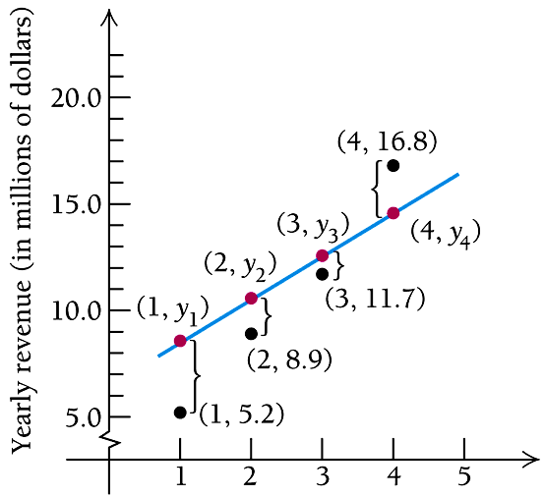
11-1 Empirical Models
Notes:
Mod 3 STAT AC Shift 1 5 1 = A; Shift 1 5 2 = B ; Shift 1 5 3 = r
2. A+BX
X Y
x1 y1
x2 y2
....
x_{n} y_{n}

Slide 12
11-2 Simple Linear Regression
We wish to fit these data points with a line,
y = β₁ x +β₀ ,
that uses values of β₁ and β₀ that, somehow, minimize
the deviations in order to have a good fit.
One way of minimizing the deviations is based on the
least-squares assumption.

Slide 13
11-2 Simple Linear Regression
Note that squaring each y-deviation gives us a sum of
nonnegative terms. Were we to simply add the
deviations, positive and negative deviations would
cancel each other out.
Using the least-squares assumption with the yearly
revenue data, we want to minimize.

Slide 14
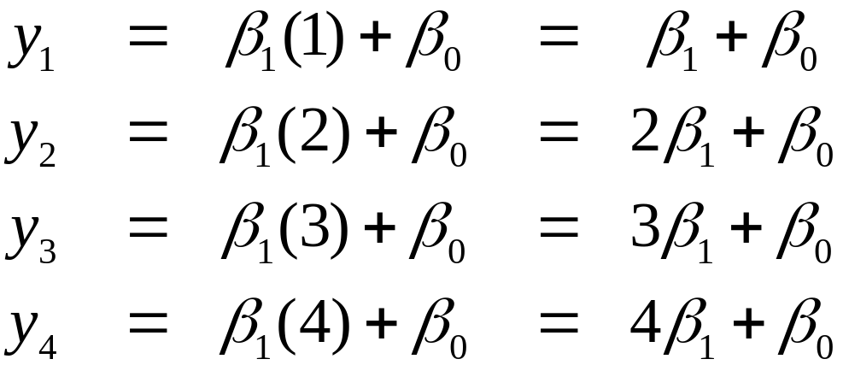
11-2 Simple Linear Regression
Also, since the points (1, y₁), (2, y₂), (3, y₃), and (4, y₄)
must be solutions of y = β₁ x + β₀ , it follows that
Substituting these values for each y in the previous
equation, we now have a function of two variables.

Slide 15
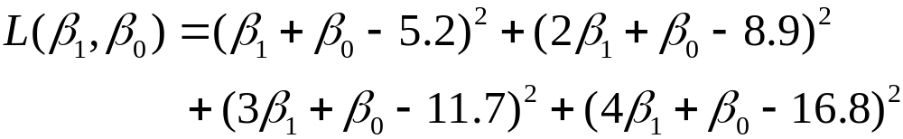


11-2 Simple Linear Regression
Thus, to find the regression line for the given set of
data, we must find the values of β₀ and β₁ that minimize
the function L given by the sum above.
We first find and .

Slide 16
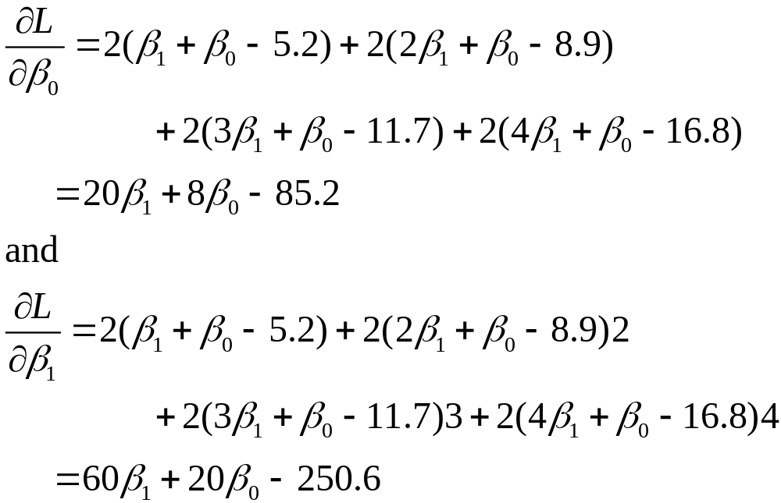
11-2 Simple Linear Regression

Slide 17
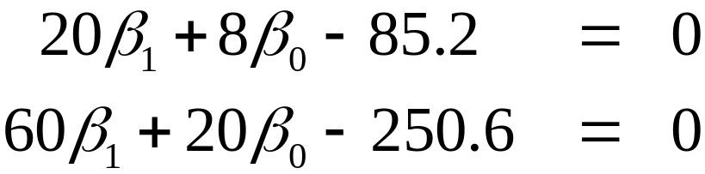
11-2 Simple Linear Regression
We set the derivatives equal to 0 and solve the resulting
system:
It can be shown that the solution to this system is
β₀ = 1.25, β₁ = 3.76.
We leave it to the student to complete the D-test
to verify that (1.25, 3.76) does, in fact, yield a
minimum of L.

Slide 18
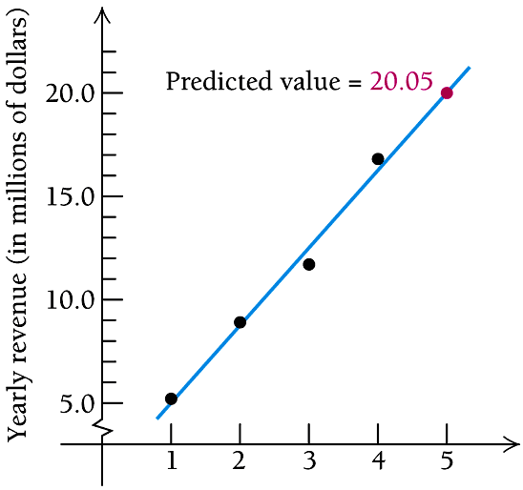
11-2 Simple Linear Regression
There is no need to compute L(1.25, 3.76). The values
of β₁ and β₀ are all we need to determine
y = β₁ x + β₀. The regression line is
y = 3.76x + 1.25.
The graph of this “best-fit” regression line together with the data points is shown below. Compare it to the
graphs before.
Slide 6.4-<number>

Slide 19
11-2 Simple Linear Regression
Now, we can use the regression equation to predict the
car rental company’s yearly revenue in 2016.
y = 3.76(5) + 1.25 = 20.05 or about $20.05 million.

Slide 20
11-2 Simple Linear Regression
The case of simple linear regression considers a single regressor or predictor x and a dependent or response variable Y.
The expected value of Y at each level of x is a random variable:
We assume that each observation, Y, can be described by the model

Slide 21
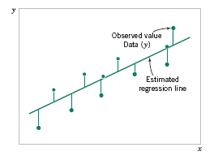
11-2 Simple Linear Regression
Suppose that we have n pairs of observations (x₁, y₁), (x₂, y₂), …, (x_{n}, y_{n}).
Figure 11-3 Deviations of the data from the estimated regression model.

Slide 22
11-2 Simple Linear Regression
The method of least squares is used to estimate the parameters, β₀ and β₁ by minimizing the sum of the squares of the vertical deviations in Figure 11-3.
Figure 11-3 Deviations of the data from the estimated regression model.

Slide 23

11-2 Simple Linear Regression
Using Equation 11-2, the n observations in the sample can be expressed as
The sum of the squares of the deviations of the observations from the true regression line is

Slide 24
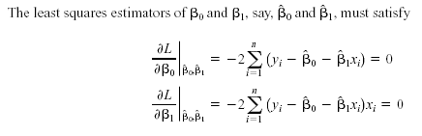
11-2 Simple Linear Regression

Slide 25
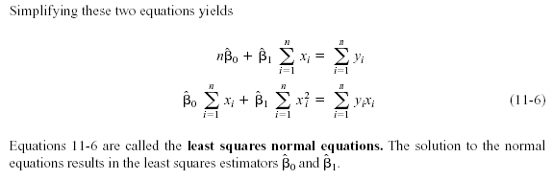
11-2 Simple Linear Regression

Slide 26
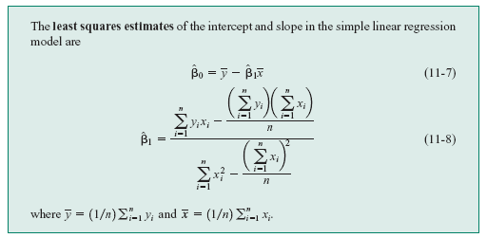
11-2 Simple Linear Regression
Definition

Slide 27
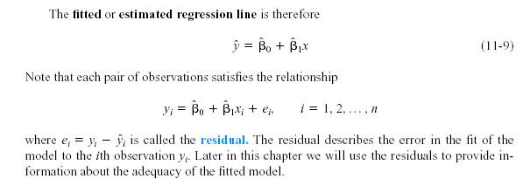
11-2 Simple Linear Regression
Notes:
Residual: phan du, thang du: adequacy sw day du

Slide 28
Example
To study the relationship between ticket prices and number of passengers on each flight, research, 11 commercial flights, we have the following data table:
Find regression line of the number of
passengers in term of ticket prices.
Number of passengers | Cost (1000$)
61 | 4.28
63 | 4.08
69 | 4.17
70 | 4.48
74 | 4.30
76 | 4.82
81 | 4.70
86 | 5.11
91 | 5.13
95 | 5.64
97 | 5.56
Notes:
y= - 24.53+21.67.x

Slide 29


11-2 Simple Linear Regression
Notation

Slide 30

11-2 Simple Linear Regression
Estimating σ²
The error sum of squares is
It can be shown that the expected value of the error sum of squares is E(SS_{E}) = (n – 2)σ².

Slide 31


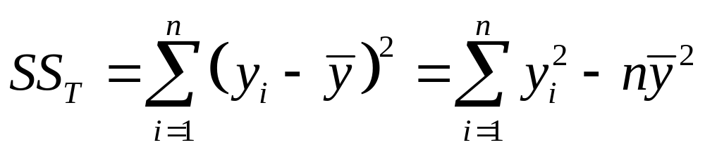
11-2 Simple Linear Regression
Estimating σ²
An unbiased estimator of σ² is
where SS_{E} can be easily computed using

Slide 32


11-3 Properties of the Least Squares Estimators
Slope Properties
Intercept Properties

Slide 33
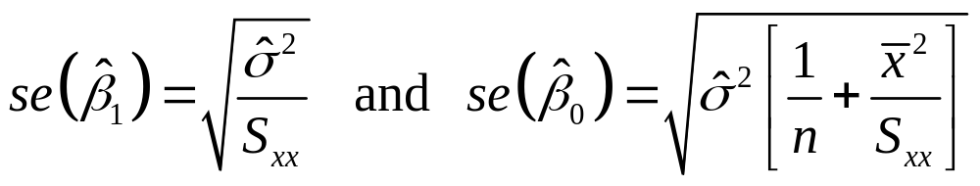

11-3 Properties of the Least Squares Estimators
In simple linear regression the estimated standard error of the slope and intercept are
respectively, where is computed from 11 -13.

Slide 34


11-4 Hypothesis Tests in
Simple Linear Regression
11-4.1 Use of t-Tests
Suppose we wish to test
An appropriate test statistic would be

Slide 35


11-4 Hypothesis Tests in
Simple Linear Regression
11-4.1 Use of t-Tests
The test statistic could also be written as:
We would reject the null hypothesis if

Slide 36


11-4 Hypothesis Tests in
Simple Linear Regression
11-4.1 Use of t-Tests
Suppose we wish to test
An appropriate test statistic would be

Slide 37
11-4 Hypothesis Tests in
Simple Linear Regression
11-4.1 Use of t-Tests
We would reject the null hypothesis if

Slide 38

11-4 Hypothesis Tests in
Simple Linear Regression
11-4.1 Use of t-Tests
An important special case of the hypotheses of Equation 11-18 is
These hypotheses relate to the significance of regression.
Failure to reject H₀ is equivalent to concluding that there is no linear relationship between x and Y.

Slide 39
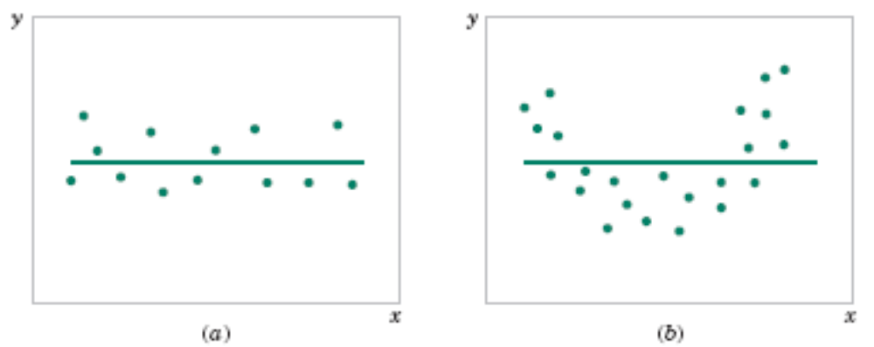
11-4 Hypothesis Tests in
Simple Linear Regression
Figure 11-5 The hypothesis H₀: β₁ = 0 is not rejected.

Slide 40
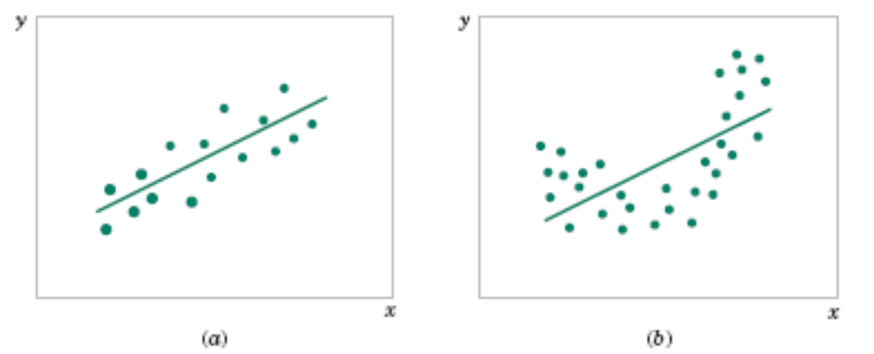
11-4 Hypothesis Tests in
Simple Linear Regression
Figure 11-6 The hypothesis H₀: β₁ = 0 is rejected.

Slide 41
11-4 Hypothesis Tests in
Simple Linear Regression
For example, in a chemical process, suppose that the yield of the product is related to the process-operating temperature.
Regression analysis can be used to build a model to predict yield at a given temperature level.
Notes:
Predict: du doan
Yield: san luong

Slide 42
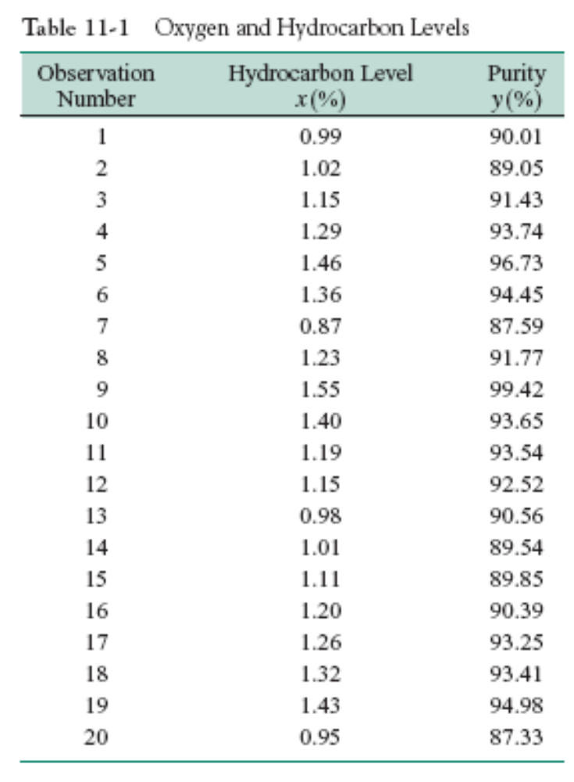
11-1 Empirical Models
Notes:
Purity: su tinh khiet; distillation: su chung cat ; condenser: binhf ngwng;

Slide 43
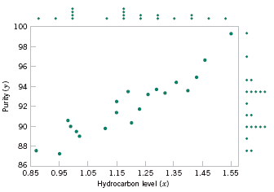
11-1 Empirical Models
Figure. Scatter Diagram of oxygen purity versus hydrocarbon level from Table 11-1.

Slide 44
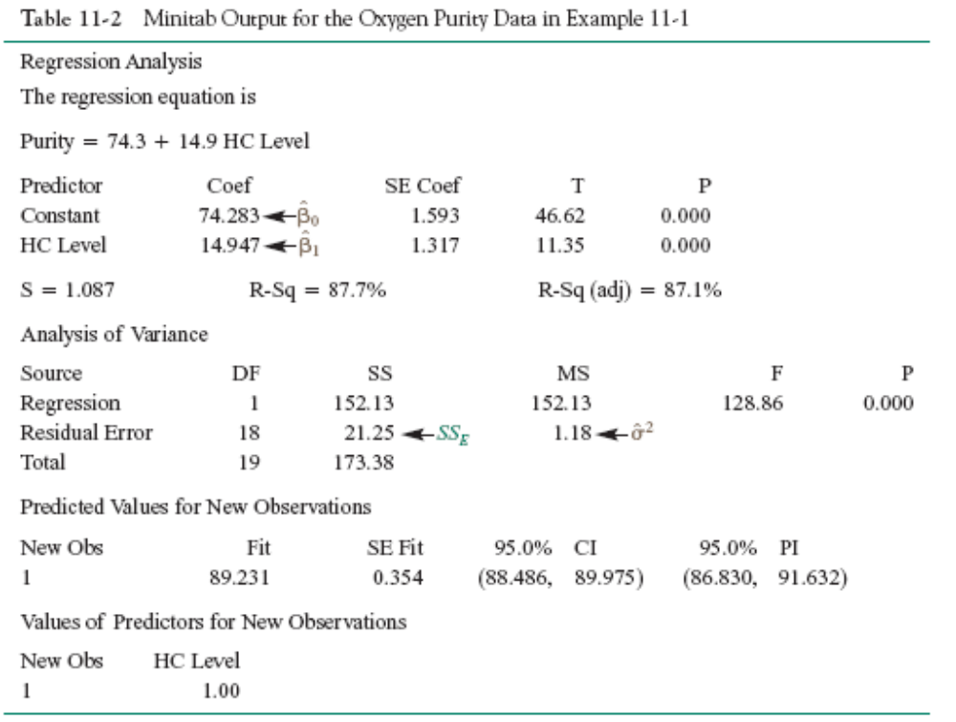
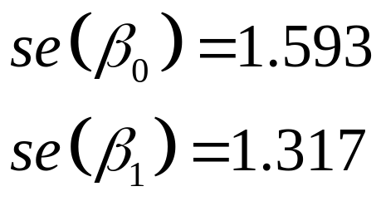

Slide 45
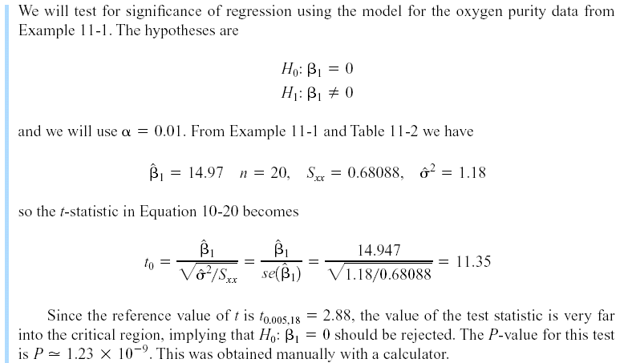
11-4 Hypothesis Tests in
Simple Linear Regression
Example 11-2

Slide 46
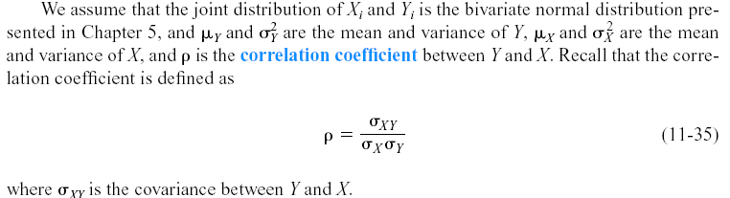
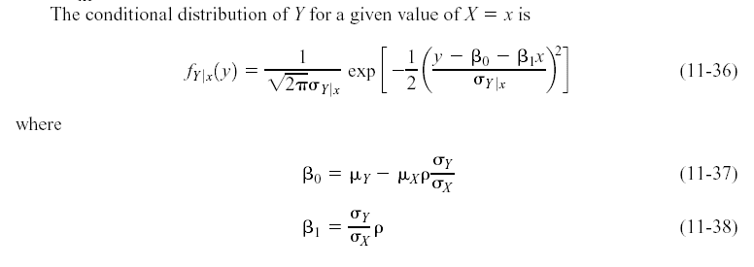
11-8 Correlation

Slide 47
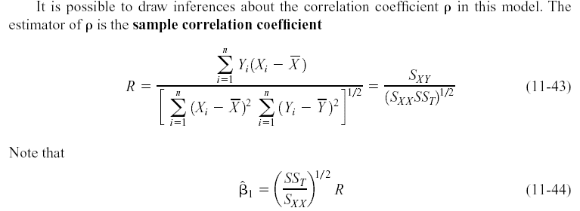

11-8 Correlation
We may also write:

Slide 48

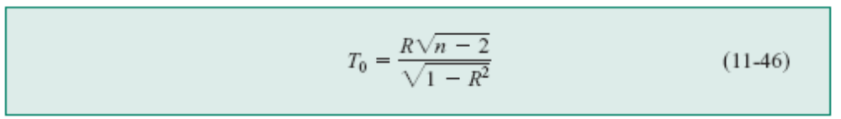
11-8 Correlation
It is often useful to test the hypotheses
The appropriate test statistic for these hypotheses is
Reject H₀ if |t₀| > t_{α/2,n-2}.

Slide 49

11-8 Correlation
The test procedure for the hypothesis
where ρ₀ ≠ 0 is somewhat more complicated. In this case, the appropriate test statistic is
Reject H₀ if |z₀| > z_{α/2}.
Notes:
Hyp 6

Slide 50
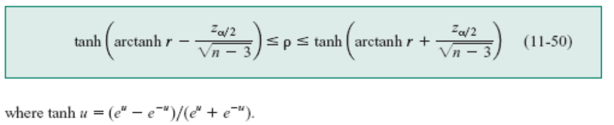
11-8 Correlation
The approximate 100(1- α)% confidence interval is
Notes:
Tanh = hyp 3

Slide 51
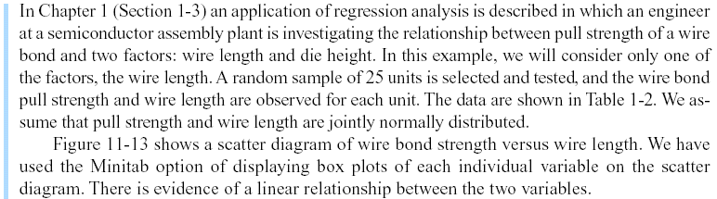
11-8 Correlation
Example 11-8

Slide 52
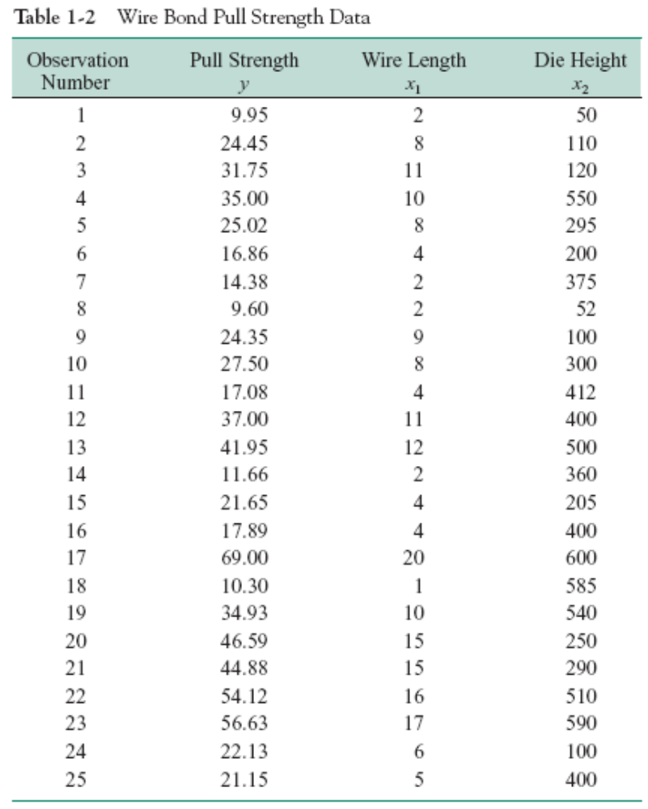

Slide 53
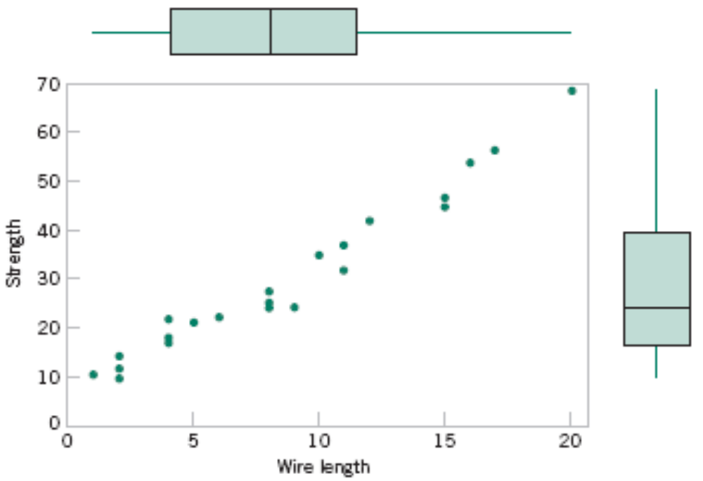
11-8 Correlation
Figure 11-13 Scatter plot of wire bond strength versus wire length, Example 11-8.

Slide 54
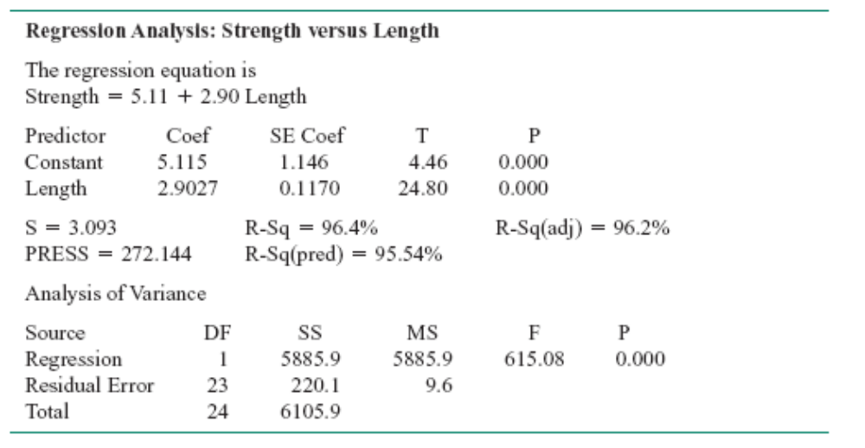
11-8 Correlation
Minitab Output for Example 11-8

Slide 55
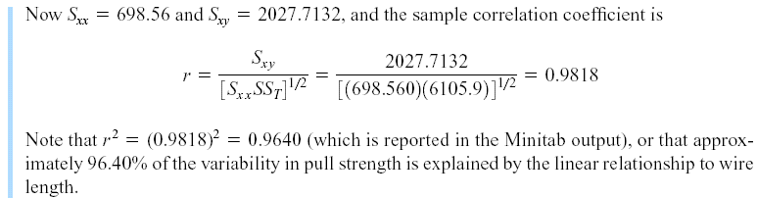
11-8 Correlation
Example 11-8 (continued)

Slide 56
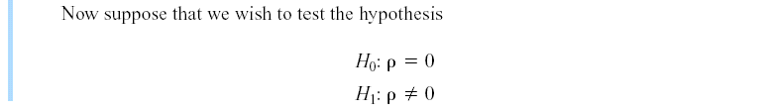
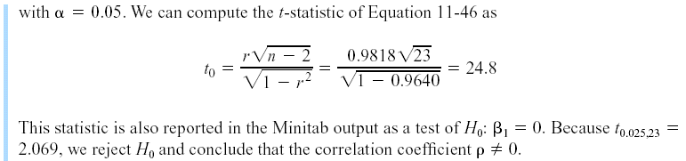
11-8 Correlation
Example 11-8 (continued)

Slide 57
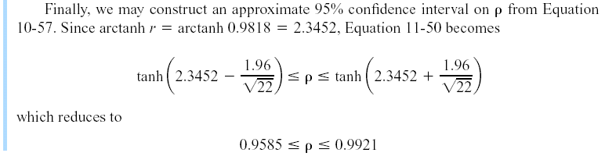
11-8 Correlation
Example 11-8 (continued)

Slide 58
